Slide 1
Salaries Based on Industry
Comparing salaries between 6 diverse careers

Slide 2
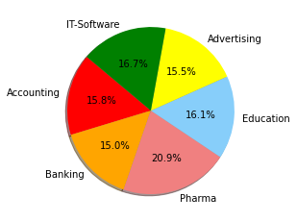
Average Salary per Field
Acounting -$4.022.00
Banking - $3,825.00
Pharma - $5,319.00
Education - $4,093.00
Advertising - $3,935.00
IT-Software - $4,260

Slide 3
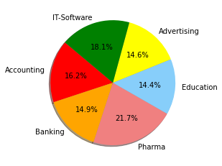
Median Salaries by Field
Field | Salary
Accounting | $3,956.00
Banking | $3,655.00
Pharma | $5,314.00
Education | $3,523.00
Advertising | $3,579.50
IT-Software | $4,434.00

Slide 4
IT-Software is by far the largest industry and accounts for over three fourths the job market

Slide 5
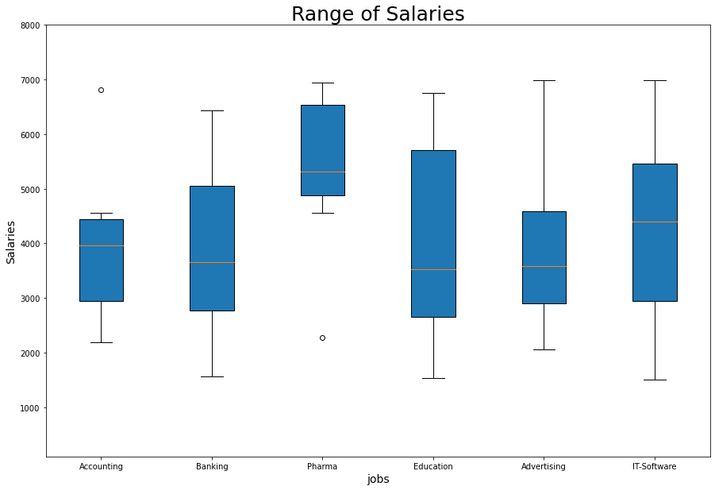
Side by Side Comparison of Ranges
Education has the largest range of salary
Accounting has the smallest range
Beside Pharma the median salary is very similar
Class | Group 1 | Group 2
Class 1 | 82 | 95
Class 2 | 76 | 88
Class 3 | 84 | 90

Slide 6
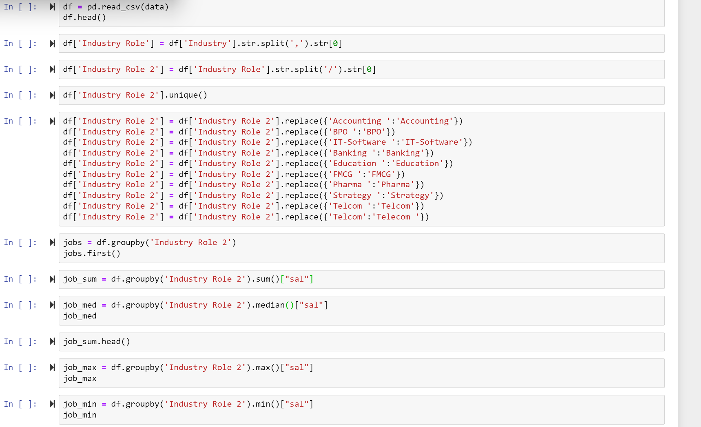

Slide 7
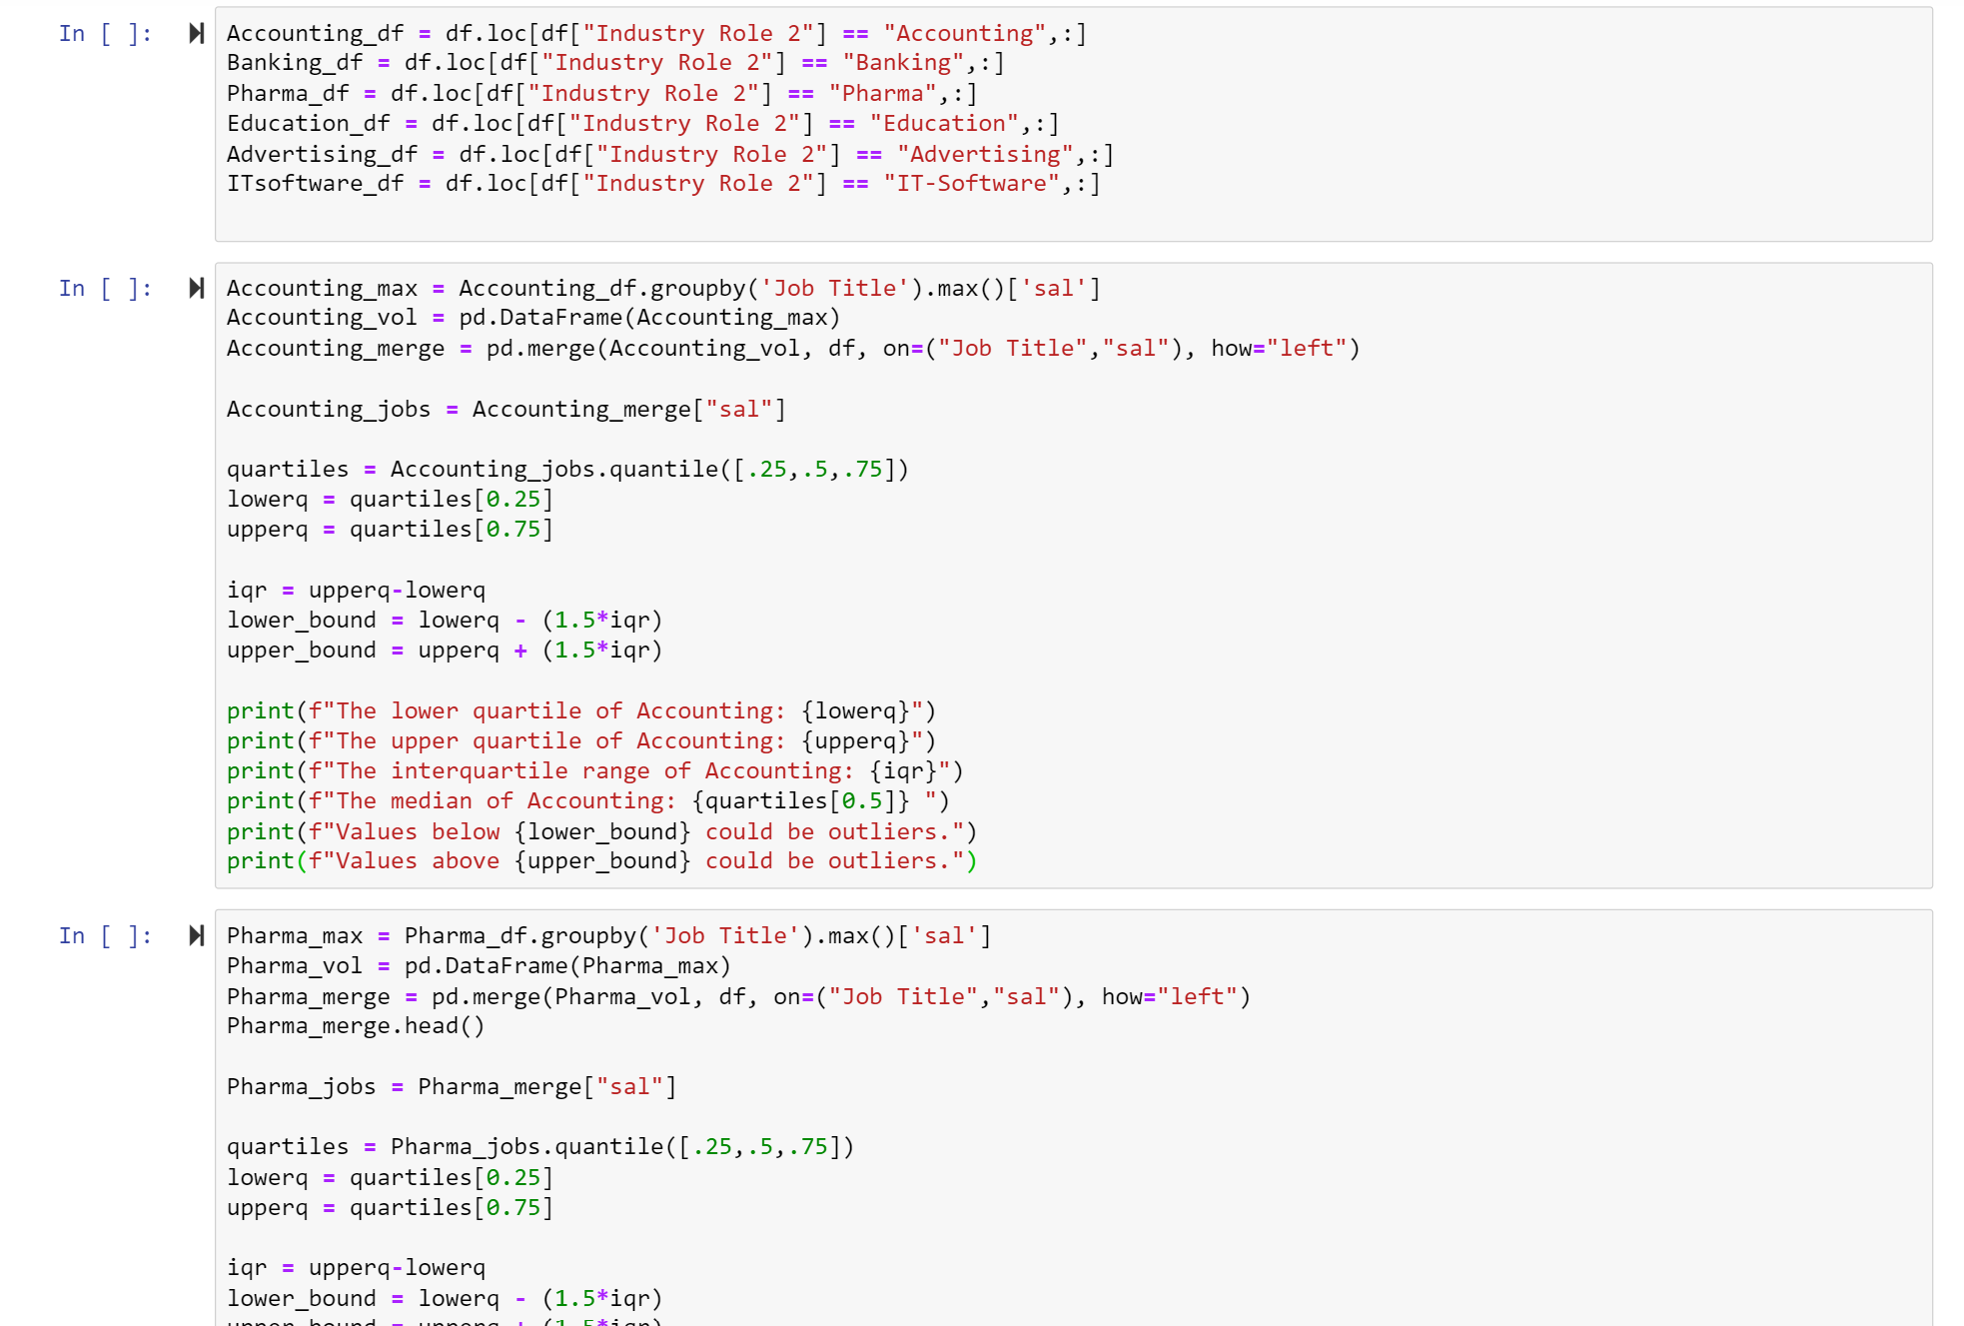

Slide 8
